Slide 1
App Fingerprinting data collection
---Group member:
Xin Yang ,Yili Zou, Tingyu Gu, Yuting Wang, Renchi Liu
CS 6350.001 - Big Data Management and Analytics

Slide 2
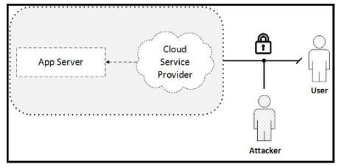
Motivation
The focus of App Fingerprinting project is to identify an app (e.g. a bank app) by listening to the encrypted TCP traffic as illustrated in Right Figure
The attacker passively gathers encrypted packets, extracts features, and uses data analytics/machine learning to predict the name of the app. This is known as App Fingerprinting, where attacker can gain information that negatively affects the peace and security of the end users or the general population at large.
Figure: App Fingerprinting data collection example

Slide 3
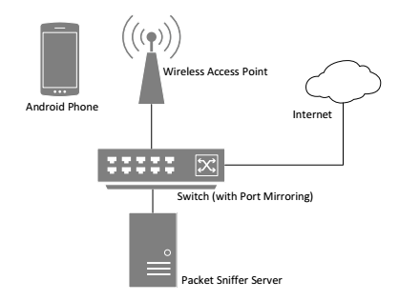
Data collection procedure
Dynamic Analysis
The dataset was collected by running multiple Android apps on a Samsung Galaxy S device, running Android version 4.3.1. Total 30,000 apps were randomly selected from three different categories in Google Play Store. The categories include Finance, Communication, and Social. Apps were then installed and launched on the phone which is connected to the Internet via a wireless router. Each trace per app is collected over a 30-sec period passively using a mirroring switch at the wireless router. These traces from such apps are then used to perform data analytics.
Figure: App Fingerprinting data collection example

Slide 4
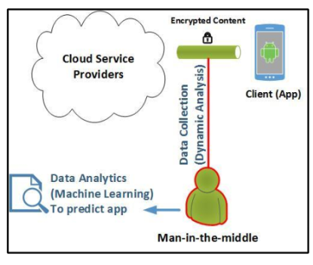
Data collection procedure
Data Analytics
The traces are used from Data Collection to determine patterns which are used for app fingerprinting. Various features from network packets are extracted and then used alongside machine learning techniques to train a model that can identify an app from its network traffic.
Figure: App Fingerprinting data collection example

Slide 5
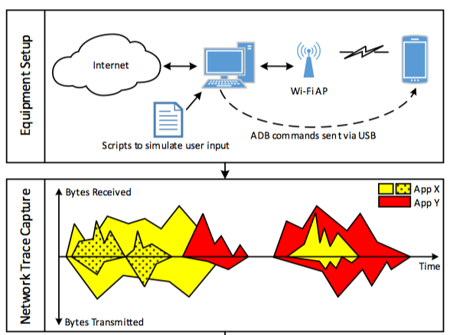
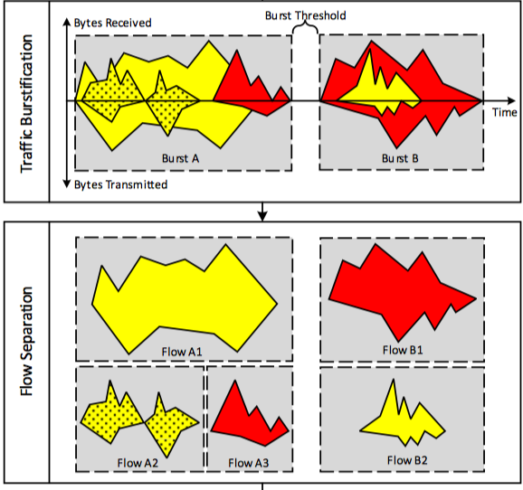
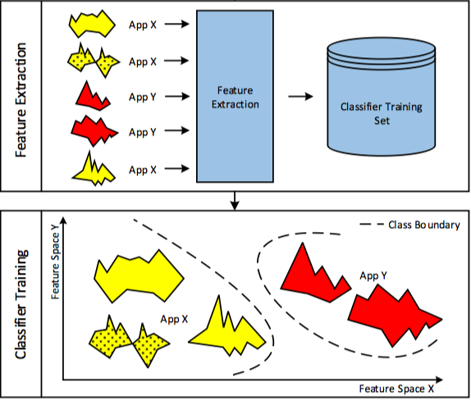
Fingerprint Making
Network Trace Capture
Trafﬁc Burstiﬁcation and Flow Separation
Feature Extraction and Classiﬁer Training:
Figure : AppScanner: Automatic Fingerprinting of Smartphone Apps From Encrypted Network Trafﬁc
Vincent F. Taylor ∗ , Riccardo Spolaor † , Mauro Conti † and Ivan Martinovic ∗

Slide 6
Fingerprint Matching
Network Trafﬁc Capturing
TCP Pre-processing and Flow Classiﬁcation
Classiﬁcation Validation

Slide 7
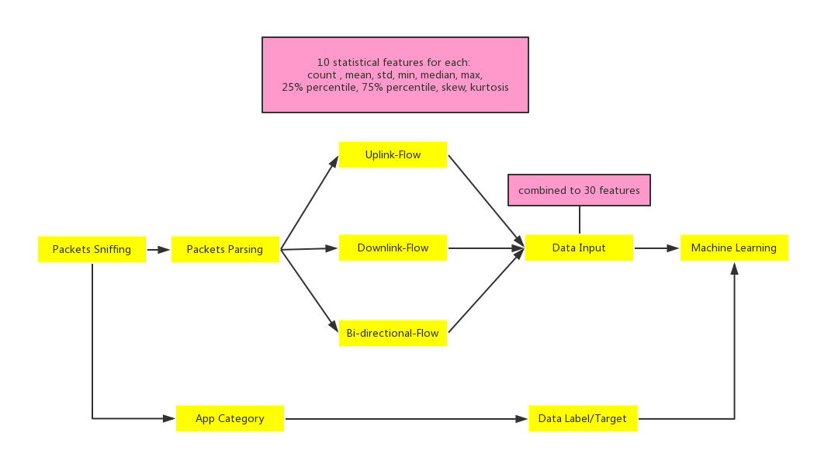
Data Flow

Slide 8
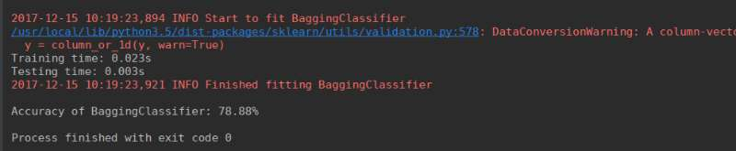
Output

Slide 9
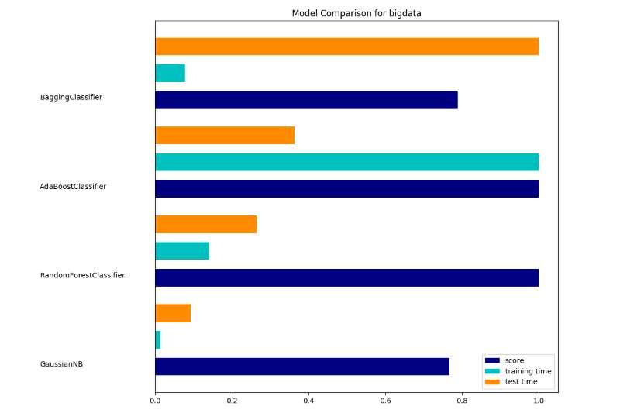
System Evaluation

Slide 10
Citation
[1]AppScanner: Automatic Fingerprinting of Smartphone Apps From Encrypted Network Trafﬁc
Vincent F. Taylor ∗ , Riccardo Spolaor † , Mauro Conti † and Ivan Martinovic ∗
[2]App Fingerprinting data collection example
[3]Adaptive Encrypted Trafﬁc Fingerprinting With Bi-Directional Dependence
Khaled Al-Naami, Swarup Chandra, Ahmad Mustafa, Latifur Khan, Zhiqiang Lin,Kevin
Hamlen, and Bhavani Thuraisingham

